Slide 1

Red Wine Quality Predictors by The Three Musketeers

Slide 2
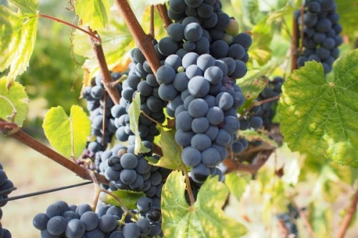
Introducing

Slide 3


Autumn Heyman
Education:
BS Alternative Medicine (Everglades University)
MPH Complementary & Alternative Medicine, Functional Nutrition (Everglades University)
MBA Non-Profit Leadership & Management (Liberty University) (currently pursuing)
Current Profession:
Sole-proprietor facilitating respite, in-home, and community service supports for adults with developmental/intellectual disabilities
Data Science Pursuits:
Field research, analyzation, and program development to address turnover, retention, and employment attraction to the field.
Tools to convert field documentation into actionable agency policies to provide more customed, tailored delivery of individual supports.
Public policy development and reform.
Favorite Languages: R and Python
Favorite Wine: Malbec

Slide 4
Erin WeaveR, CSW
Education:
BA International Languages & Cultures
AA International Business
AS Accounting
Certified Specialist of Wine
Current Profession:
Staff Accountant
Data Science Pursuits:
Favorite Language: R & SQL
Favorite Wines: Mourvedre & Carmenere

Slide 5
Georgia Miller
Army National Guard veteran with a background in GIS
Education:
Responsive Web Design Certificate FreeCodeCamp
Google Data Analytics Certificate Coursera
BS Accounting Western Governors University
Current Profession:
Operations Administrator for premier auto hauler
Data Science Pursuits:
Research analytics, field modeling
Favorite Language: R / Python
Favorite wine: Merlot

Slide 6
BACKGROUND

Slide 7

Wine Quality

Slide 8
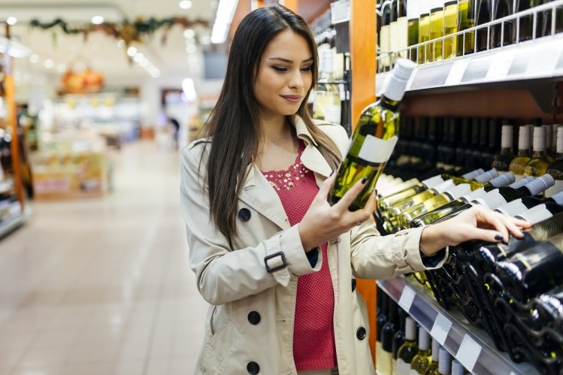
Wine Quality - Consumer
Subjective
Packaging
Rating
Value
Personal Preference

Slide 9
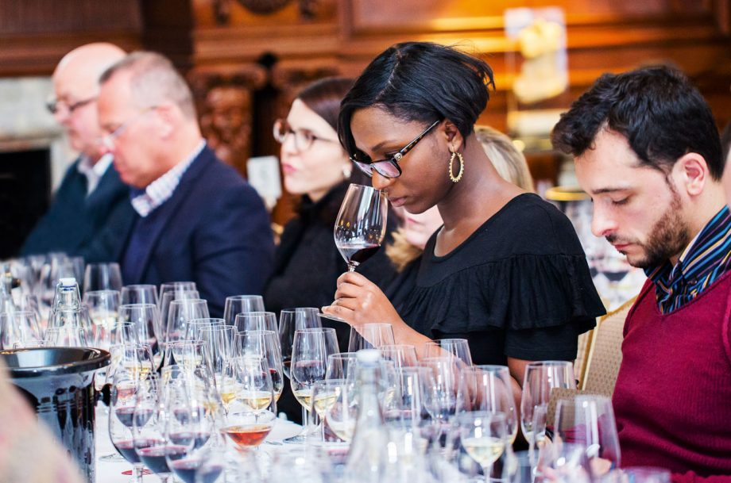
Wine Quality – INdustry Professionals
Objective
Systematic approach

Slide 10
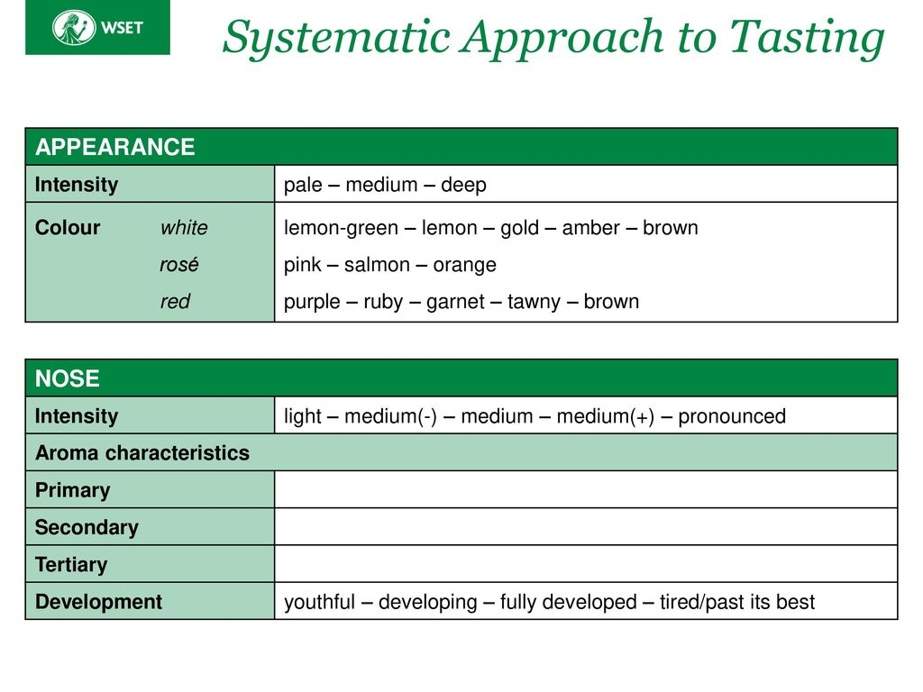

Slide 11
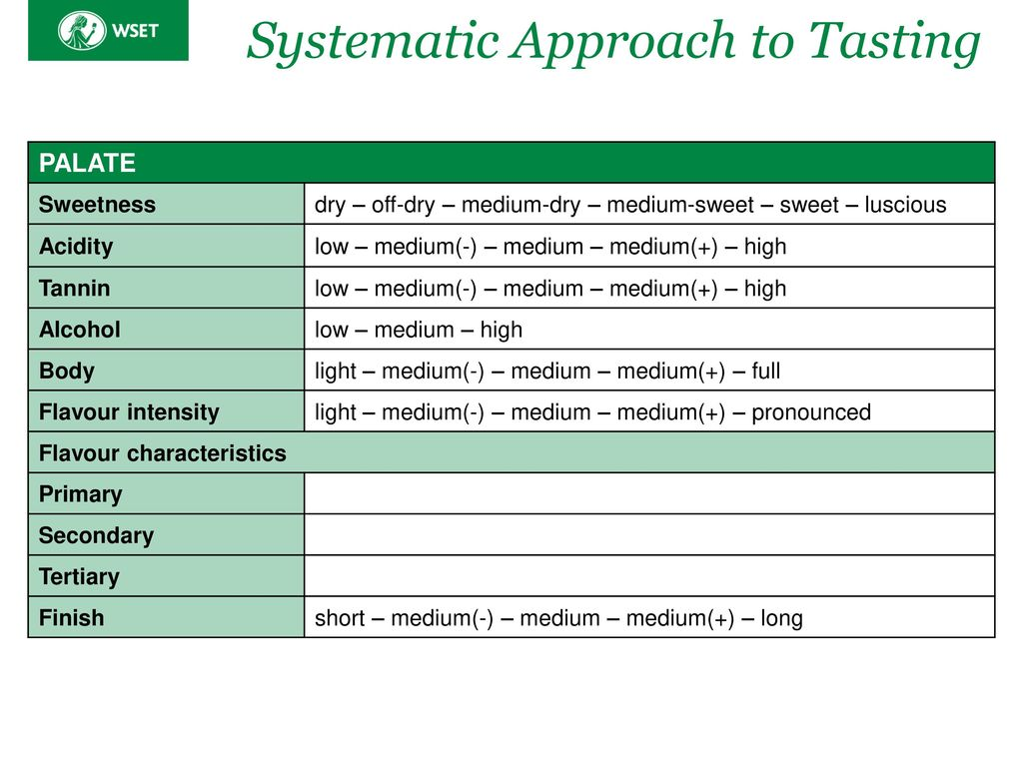

Slide 12
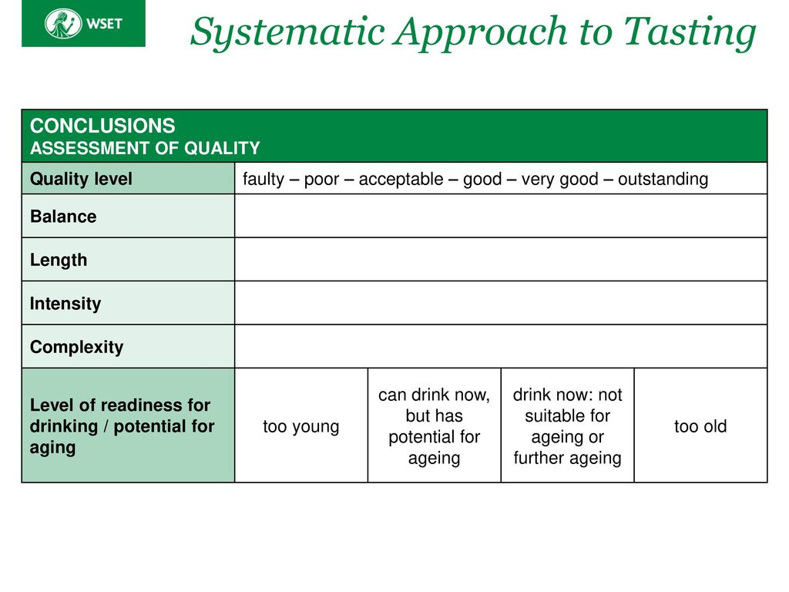

Slide 13
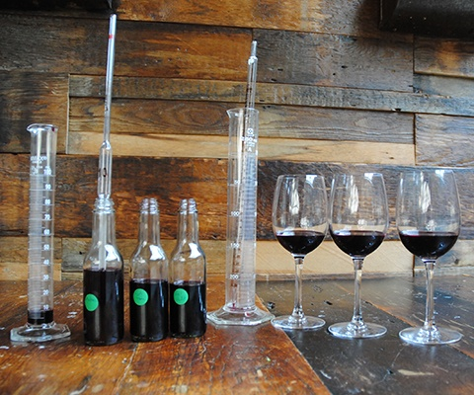
Wine Quality – Producer
Objective & Subjective
Terroir, Climate, Weather
Grape Ripeness
During the vinification process, numerous techniques can be used to correct for flaws or adjust the final profile of the wine before the final product reaches the consumer.

Slide 14
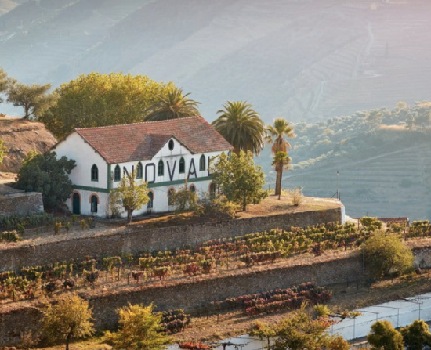
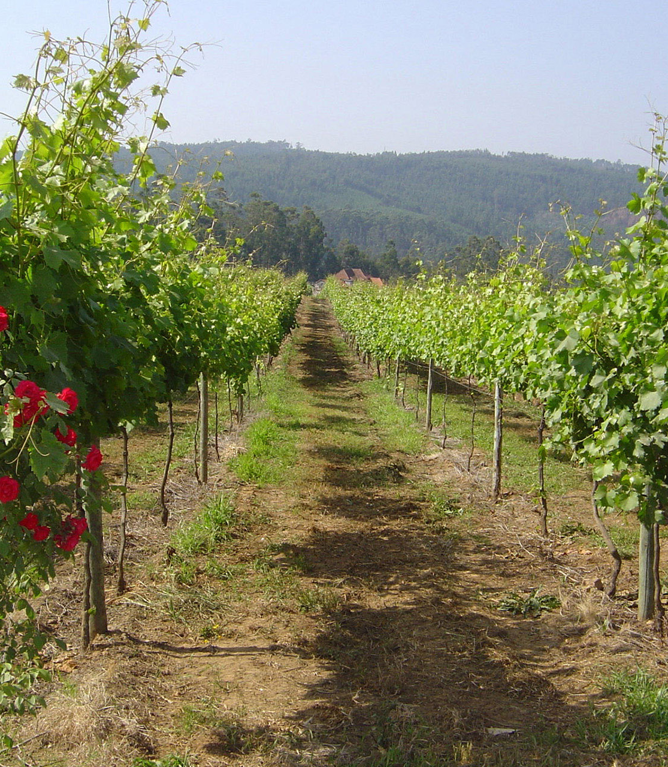
PURPOSE :
Due to the lack of red wine quality data (Minho region) & regional/global competition initiatives, as data scientists:
We recognize the opportunity for winemakers to:
1. Capitalize on this data: improve decision making processes
2. Bring these ‘rare’ red wines to more tables across the globe.

Slide 15
ProjecT Background: Portuguese wine Production & Exports
Portugal: 5th largest wine producer in Europe, 11th largest in the world
2020: Despite COVID-19 pandemic: Portuguese wine exports ⬆️5% compared to 2019.
306 million liters of wine exported, valued at $936 million
2021: Portuguese wines grew 3.8% (volume), 8.6% (value), 4.6% (average price) from 2020.
Ministry of Agriculture: has honed its focus on monitoring farmers and wine producers.
Why? The increasing value of Portuguese wine, currently in competition with France, the United States, the United Kingdom, Brazil, and Germany
Action Plan: Define & implement measures to guarantee predictability/stability in Portuguese wine production.
Wine certification and quality assessment are key elements within this context.

Slide 16
The DATASET

Slide 17
The DataSet
2009 Study led by Paulo Cortez at the University of Minho in Guimarães
1599 wrangled down (for NAs) to 1143 red wines from Minho were analyzed for 11 chemical properties
Fixed Acidity, Volatile Acidity, Citric Acid, pH
Total Sulfur Dioxide, Free Sulfur Dioxide, Sulphates
Residual Sugar, Chlorides, Density, Alcohol
Ranked for Quality on an 11 point scale

Slide 18
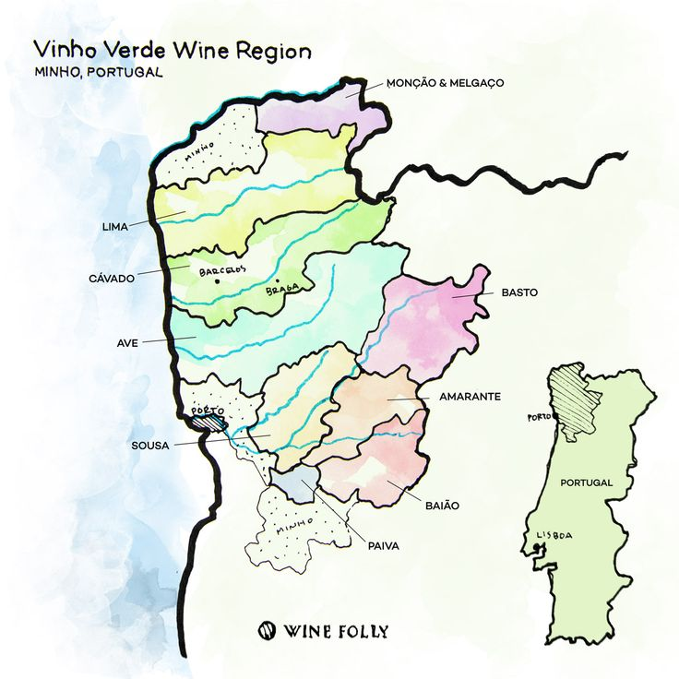
Wine region
Vinho Verde
Alvarinho & Loueiro
Amaral, Borraçal
Vinho Verde is particularly known for its bright, summery white wines with subtle carbonation.
Red and rosé Vinho Verde wines are the region's ‘rare gems’.
Cool, rainy climate -> more difficult to ripen the red varieties

Slide 19
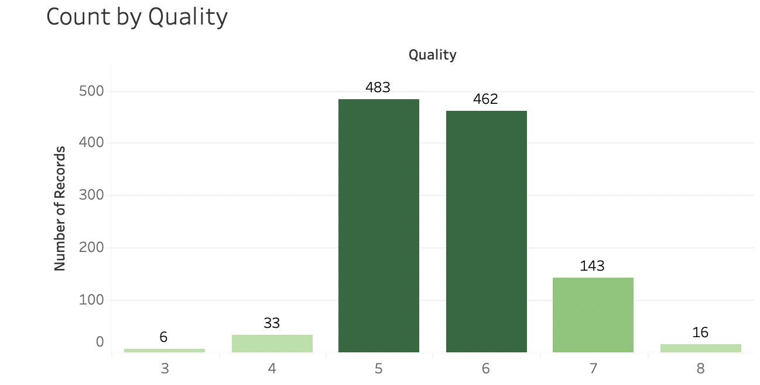
The DataSet
Skewed towards the middle
83% of records classified as either a 5 or 6 in quality

Slide 20
Questions
Which physiochemical properties of wine have the greatest impact on wine quality?
How do those properties individually impact quality?
What balance or interplay between those properties is necessary for the best quality wine?

Slide 21
Methodology

Slide 22
METHODS Overview
Stepwise Binary Logistic Regression
Ordinal Logistic Regression / Confusion matrix
KMeans
Linear Discriminant Analysis
Recoded quality into three groups
3-4 ”poor”
5-6 “average”
7-8 “good”

Slide 23
METHODS – Assessing Impact
Original plan of action: Stepwise Binary Logistic Regression/KMeans Model
Tried stepwise binary logistic regression, results messy
Ran KMeans model to see how the results looked, no clear answers

Slide 24
METHODS – Assessing Relationship
New plan of action: Ordinal Logistic Regression/Linear discriminant analysis
Googled OLR steps, received mixed results for set up, melded methods together based on needs
Recoded quality 5,6,7-8 and 3-4,5-6,7-8 to see the difference in distribution
Decided to go with 3-4,5-6,7-8 due to more even distribution
Ran LDA with outliers and without outliers to compare accuracy

Slide 25
RESULTS

Slide 26
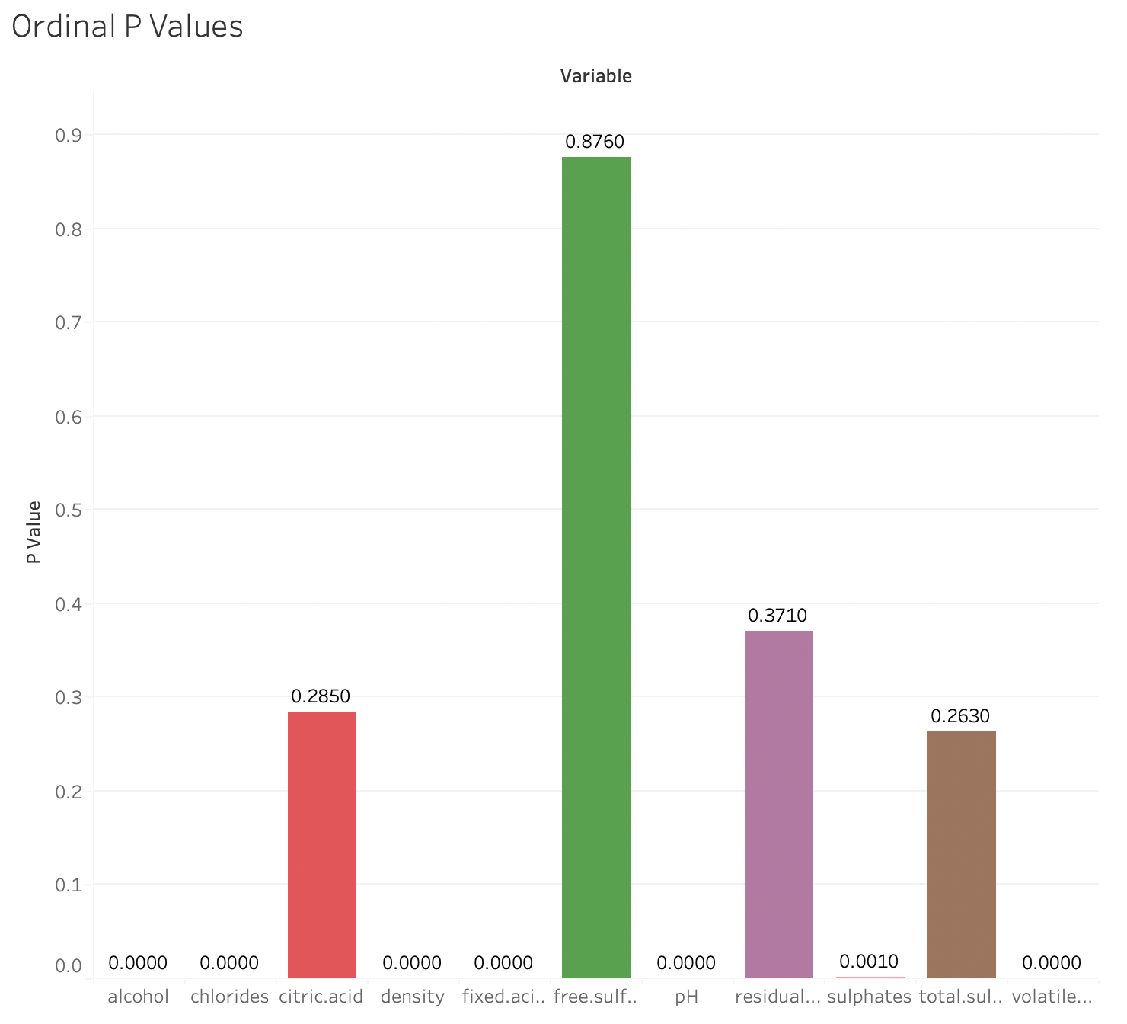
Results – Impact Analysis

Slide 27
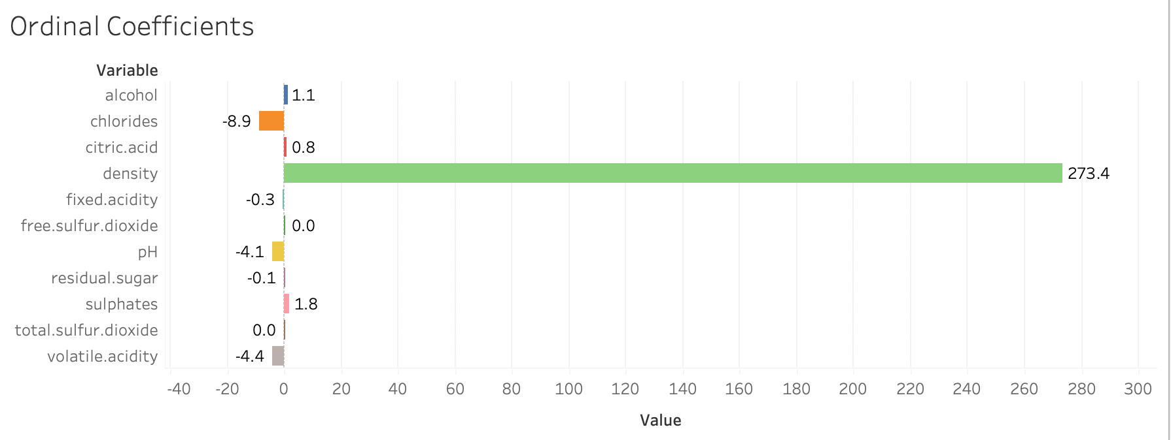
Results – Impact Analysis

Slide 28
Results – Relationship Analysis

Slide 29
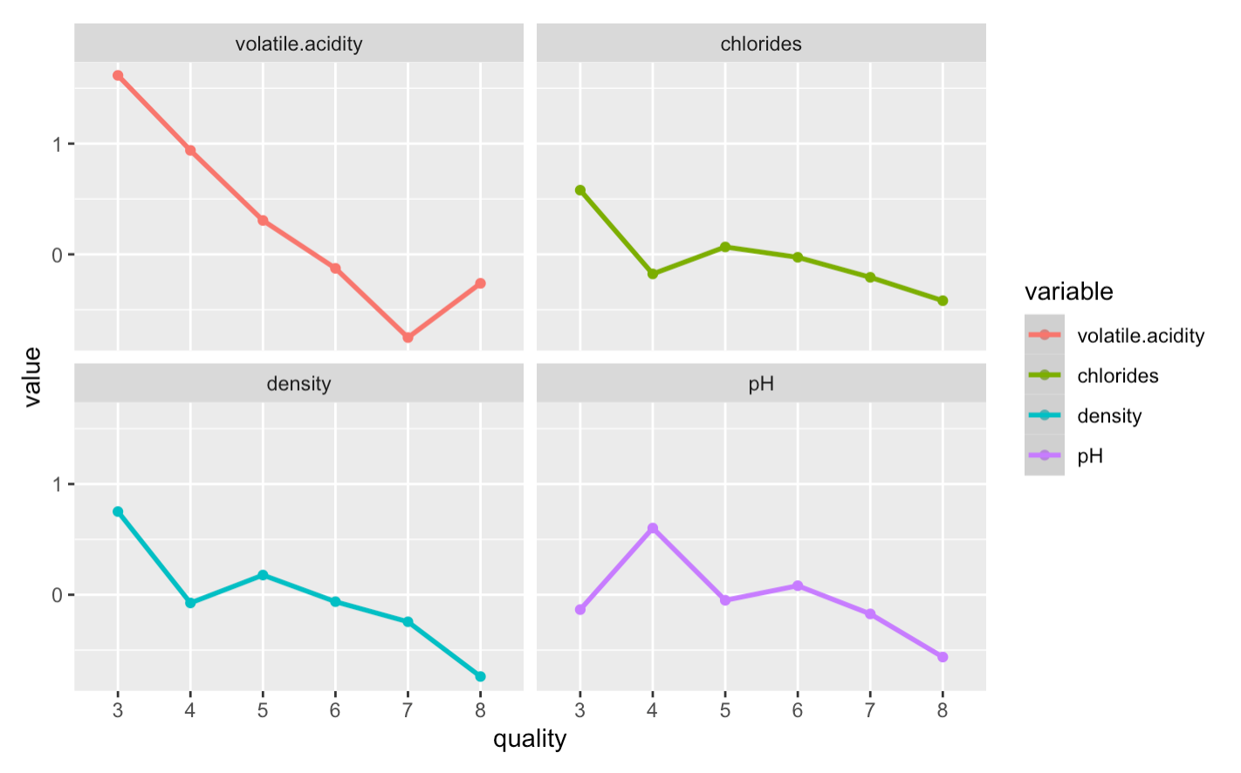

Slide 30
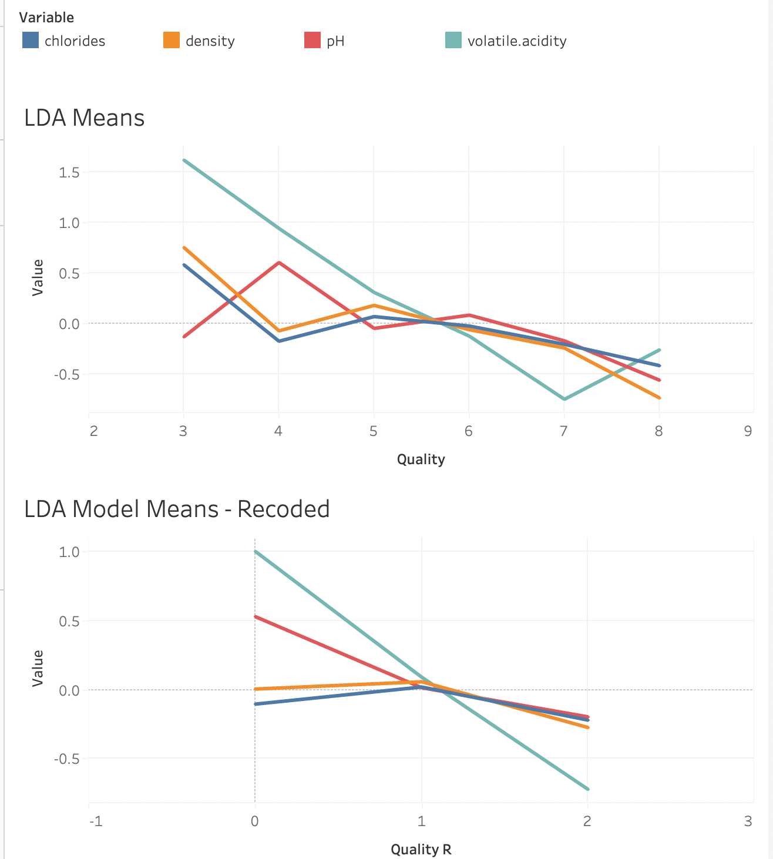

Slide 31
Results – Relationship Analysis
Discussion about variance between the means ratio for each quality level

Slide 32
SUMMARY & CONCLUSIONS

Slide 33
Summary
Our analysis indicates that of the 11 measured properties of wine, 7 had a significant impact on quality score.
Top 4 Variables
Analyzed how they individually and collectively impacted quality

Slide 34
Conclusions
Wine quality is both subjective & objective
Quality is not determined by one property, but by several
Quality is affected by the ratio between those properties
There are other variables that could be affecting our data & results

Slide 35
QUESTIONS ?

Slide 36



